Slide 1


Bioinformatics Tools
Course: Scripting Language Python
Prepared by:
Ahmed Ali
Ahmed Mohsen
Heba Allah Mohamed
Nancy Alaa
Nourhan And Elnasser
Abanoub Nagy

Slide 2
Content
Project Description
Tools used
Website Features

Slide 3
Project Description
This project provides solutions to some biological problems using Python.
Problems solved:
Generate random fasta file
Search for patterns in sequence
Find the minimum skew of sequence and GC content percentage
Find most frequent patterns with specific k-mer
Detecting Breast Cancer
Tools used:
Python
ML
Streamlit (GUI)

Slide 4
Generate random fasta file
Input: Number of sequences, Range of sequences length
Output: Fasta file
Time complexity: O(n*m), where n is the number of sequences and m is length sequence

Slide 5
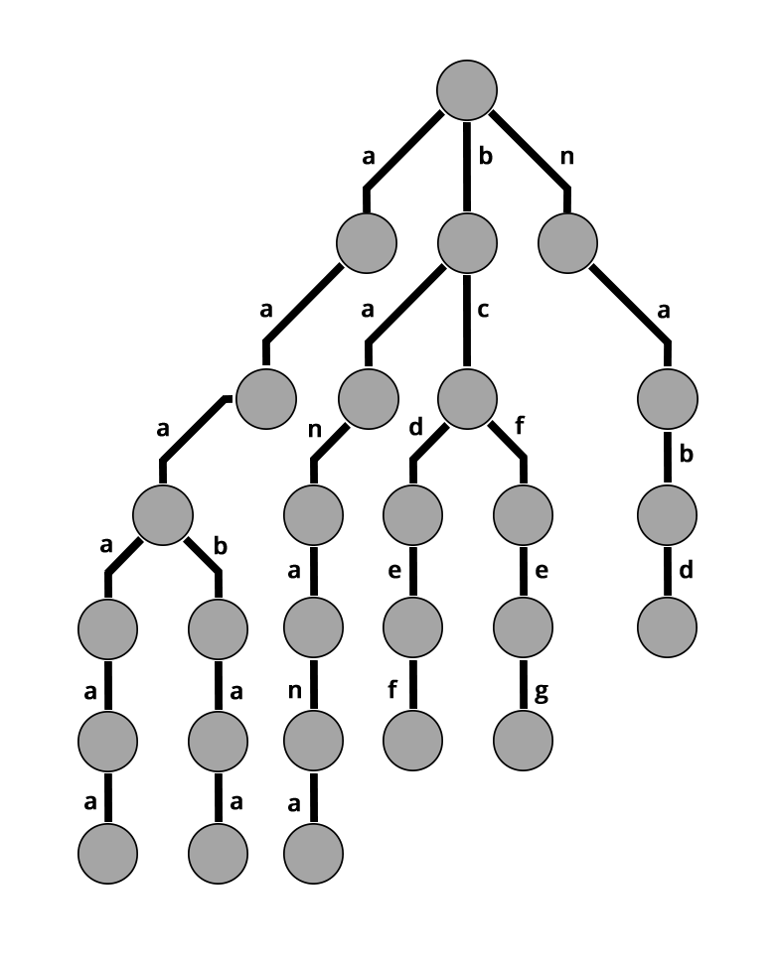
Search for patterns in sequence
Input: sequence, patterns
Output: whether each pattern is found in sequence or not
Algorithms used: Suffix tree
Time complexity: O(m) , where m is the length of the sub-string

Slide 6
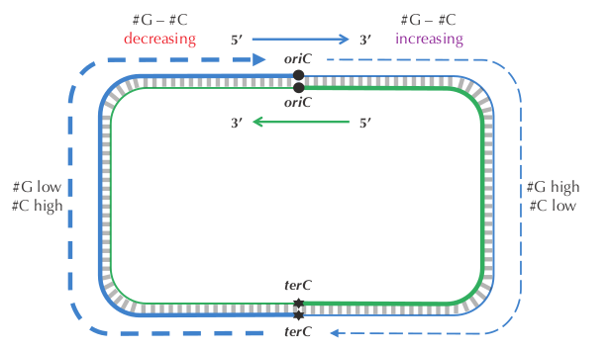
Find a Position in a Genome Minimizing the Skew
The difference between the total amount of guanine and the total amount of cytosine is negative on the reverse half-strand (201634 219518 = 17884) and positive on the forward half-strand (211607 207901 = 3706).
Thus, our idea is to traverse the genome, keeping a running total of the difference between the counts of G and C . If this difference starts increasing, then we guess that we are on the forward half-strand; on the other hand, if this difference starts decreasing, then we guess that we are on the reverse half-strand.
Thus, the skew should achieve a minimum at the position where the reverse half-strand ends and the forward half-strand begins, which is exactly the location of oriC!

Slide 7
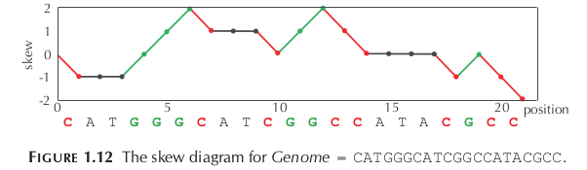
we can compute SKEW i + 1 ( Genome ) from SKEW i ( Genome ) according to the nucleotide in position i of Genome. If this nucleotide is G , then SKEW i + 1 (Genome ) = SKEW i ( Genome ) + 1; if this nucleotide is C , then SKEW i + 1 ( Genome ) = SKEW i ( Genome ) 1; otherwise, SKEW i + 1 ( Genome ) = SKEW i ( Genome ) .

Slide 8
Find most frequent patterns with specific k-mer
Input: sequence, pattern k-mer
Output: The most frequent patterns with this k-mer
Time complexity: O(n)

Slide 9
Find transcription DNA sequence
Input: DNA sequence
Output: MRNA sequence
Time complexity: O(n)

Slide 10
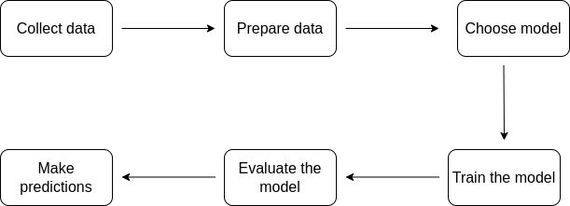
Detecting Breast Cancer
Analyse and build a model to predict if a given set of symptoms lead to breast cancer.
This is a binary classification problem
Steps token are
Collect and Prepare the data
Choose model, and models used here to reach the most accurate results are:
Training the model
Evaluating the model
Making prediction

Slide 11
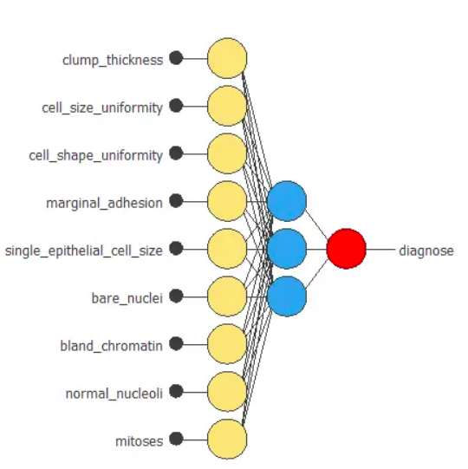
Attribute Information:
Clump Thickness: Benign cells tend to be grouped in monolayers, while cancerous cells are often grouped in multilayers.
Uniform Cell Size: Cancer cells tend to vary in size and shape.
Uniform Cell Shape: Cancer cells tend to vary in shape and size.
Marginal Adhesion: Normal cells tend to stick together while cancer cells tend to lose this ability, so the loss of adhesion is a sign of malignancy.
Single Epithelial Cell Size: It is related to the uniformity mentioned above. Epithelial cells that are significantly enlarged may be a malignant cell.
Bare Nuclei: This is a term used for nuclei not surrounded by cytoplasm (the rest of the cell). Those are typically seen in benign tumors.
Bland Chromatin: Describes a uniform "texture" of the nucleus seen in benign cells. In cancer cells, the chromatin tends to be more coarse and to form clumps.
Normal Nucleoli: Nucleoli are small structures seen in the nucleus. In normal cells, the nucleolus is usually very small if visible at all. The nucleoli become more prominent in cancer cells, and sometimes there are multiple.
Mitosis: Cancer is essentially a disease of uncontrolled mitosis.

Slide 12
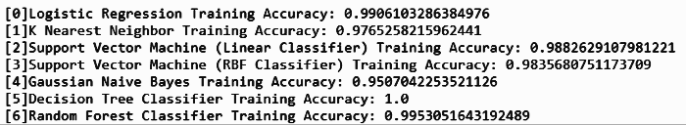
Accuracy of model

Slide 13
Resources
https://www.neuraldesigner.com/learning/examples/breast-cancer-diagnosis
https://github.com/gayathri1462/Breast-Cancer-Detection-Web-App/blob/main/Breast_Cancer_Detection.ipynb
Bioinformatics Algorithms:An Active Learning Approach 2nd Edition, Vol. I

Slide 14
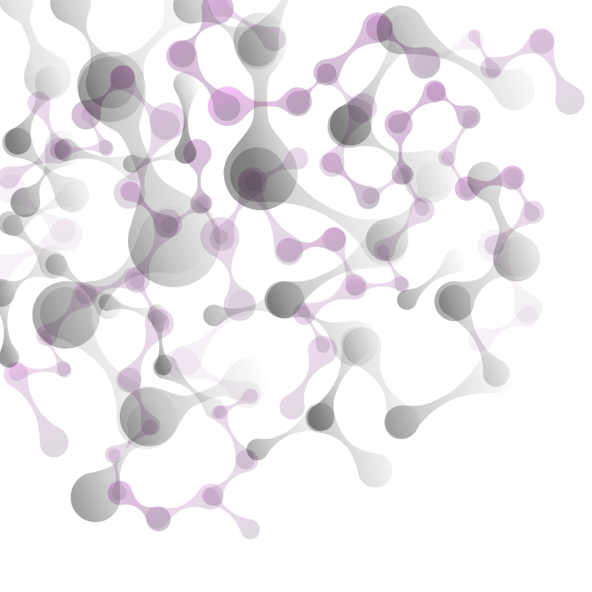
Thank You
Thank You

